Slide 1
Week 9&10
File created on: 8/9/2023 6:58:33 PM

Slide 2


Slide 3
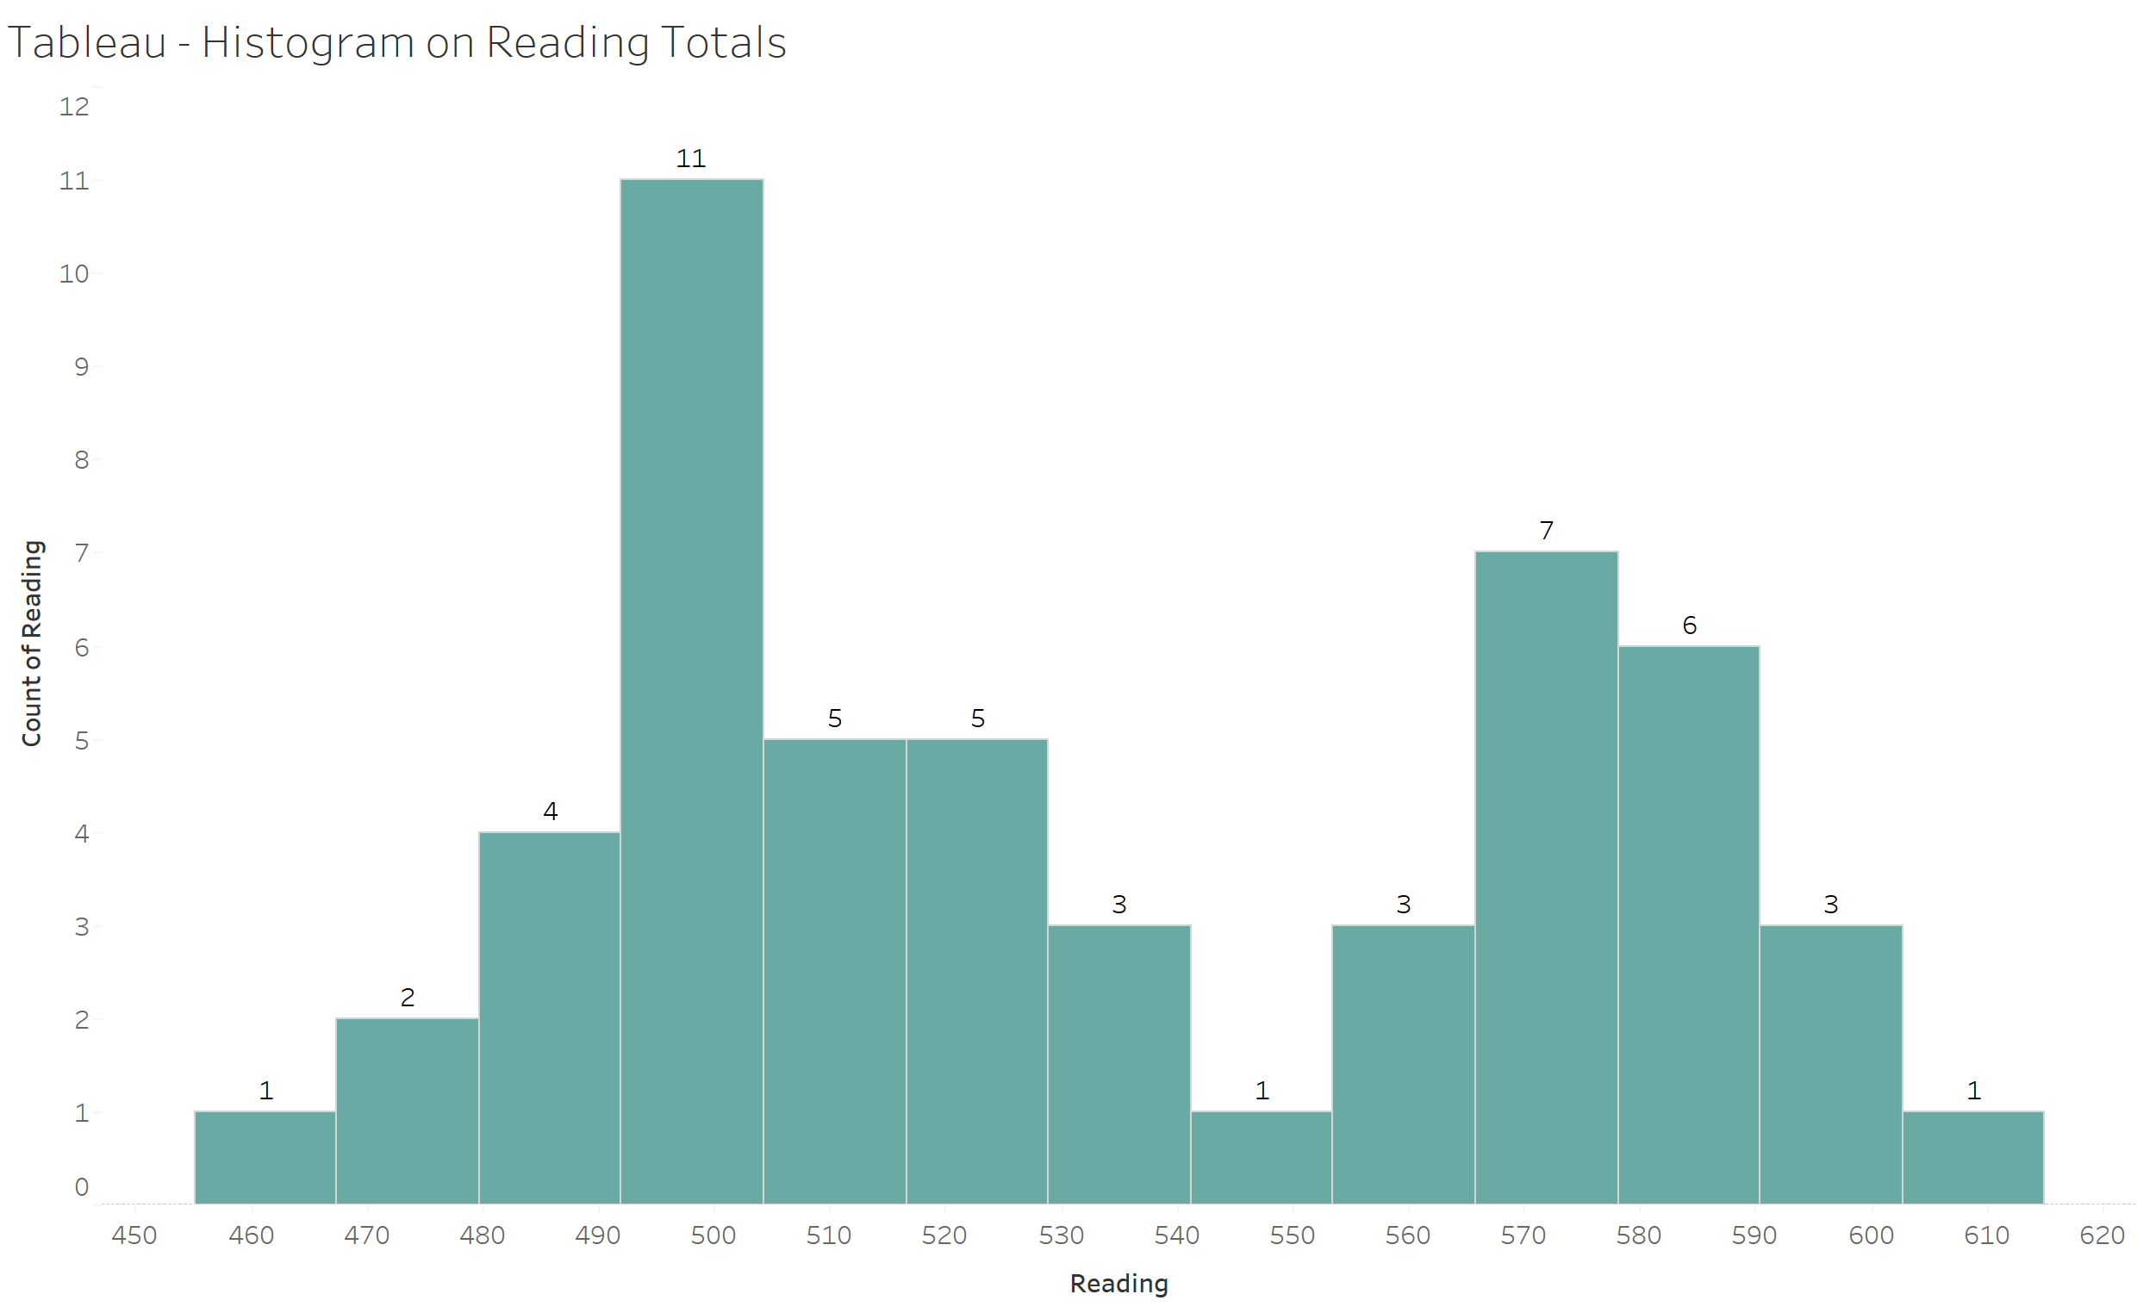

Slide 4
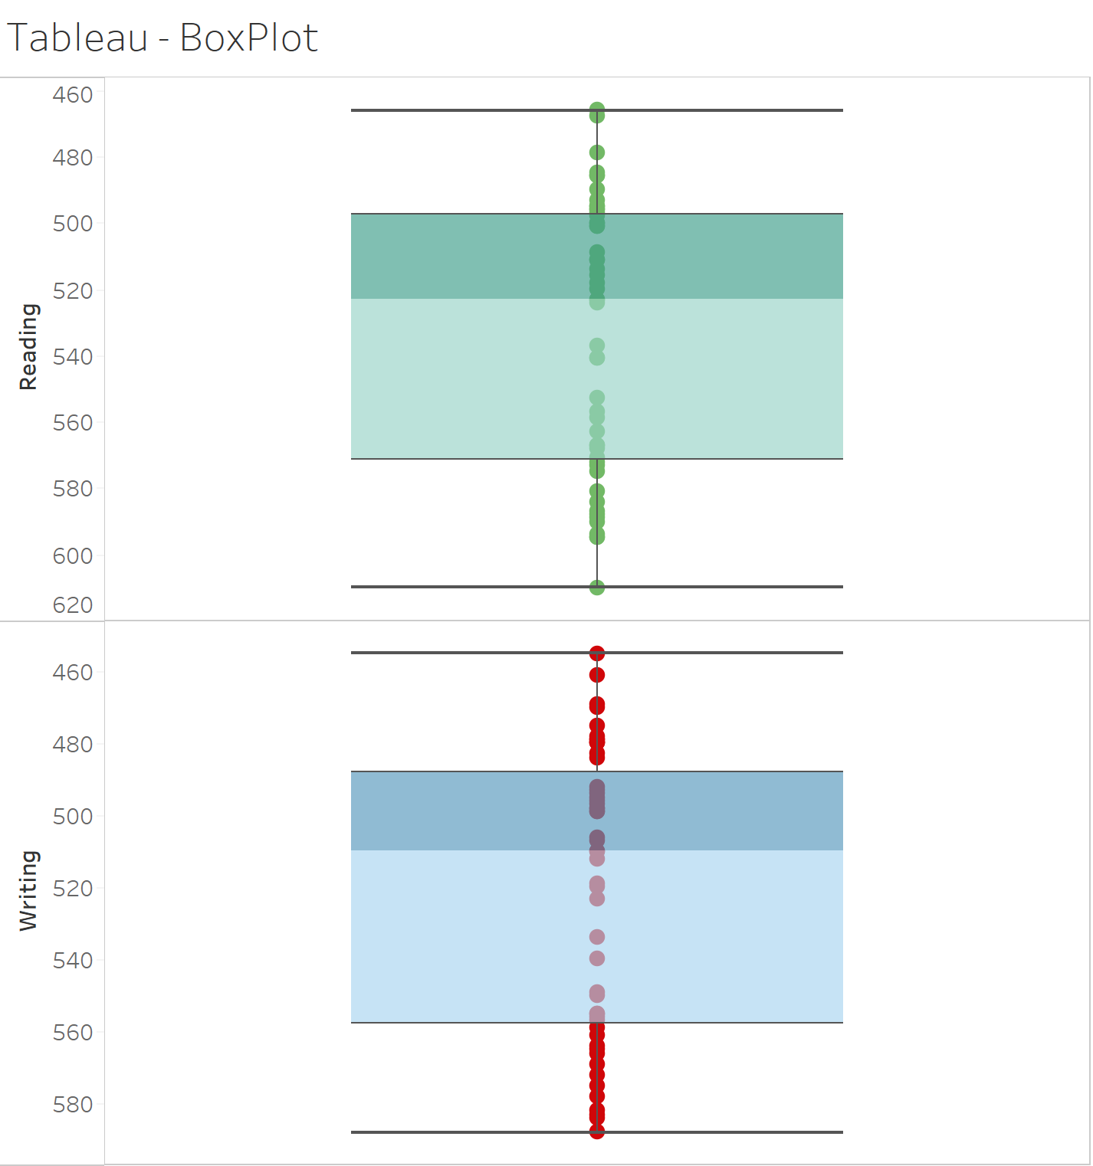

Slide 5
